Slide 1
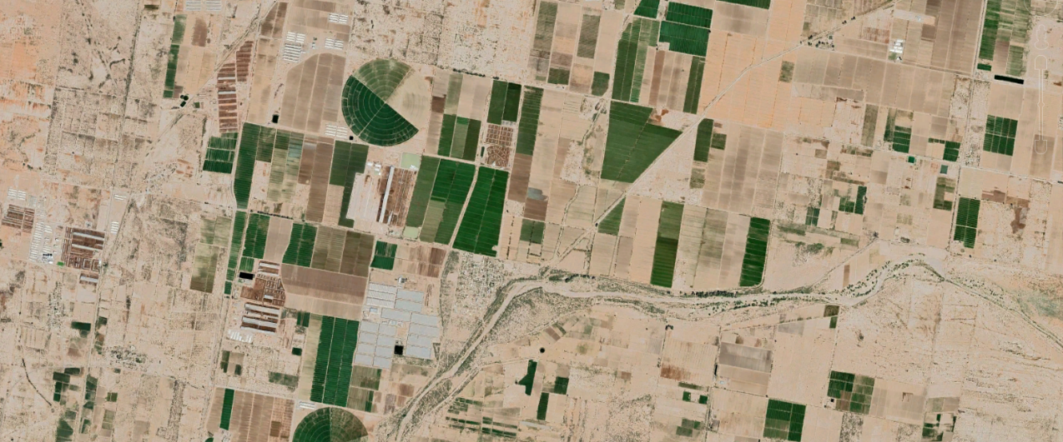



Using earth observation data to improve climate-modifying habitat datasets for pest risk modelling
Tim Beale (CABI), Pascale Bodevin (CABI), Steve Edgington (CABI), Libertad Sanchez Presa (CABI), Bryony Taylor (CABI), Alex Cornelius (Assimila), Gerardo Lopez Saldana (Assimila), Jon Styles (Assimila), Darren J. Kriticos (Cervantes Agritech)
Presented by Tim Beale at IPRRG Annual Meeting, Nairobi, Kenya. September 2023

Slide 2
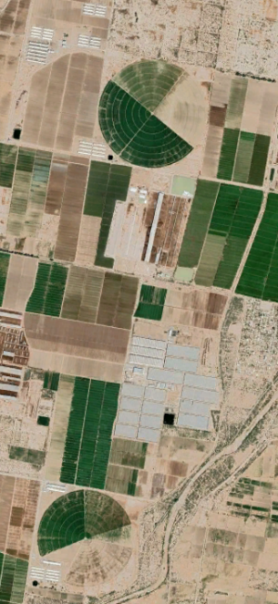



Using earth observation data to improve climate-modifying habitat datasets for pest risk modelling
Introduction
Timeline of the project(s)
Irrigated areas
Protected Agriculture (PA)
Canopy temperature
Goals and next steps

Slide 3

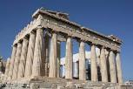


Timeline
Global irrigation data product
Protected agriculture datasets (UK & Australia)
Canopy temperature datasets (UK & Australia)
Demonstrator pest models showcasing new datasets
Papers publishing methods
EO4AgroClimate
Prototype irrigation method
IPRRG 22
IPRRG 23
Phase 1
Jan 22
Mar 22
Oct 22
Phase 2
Apr 23
Sept 23
Mar 25

Slide 4
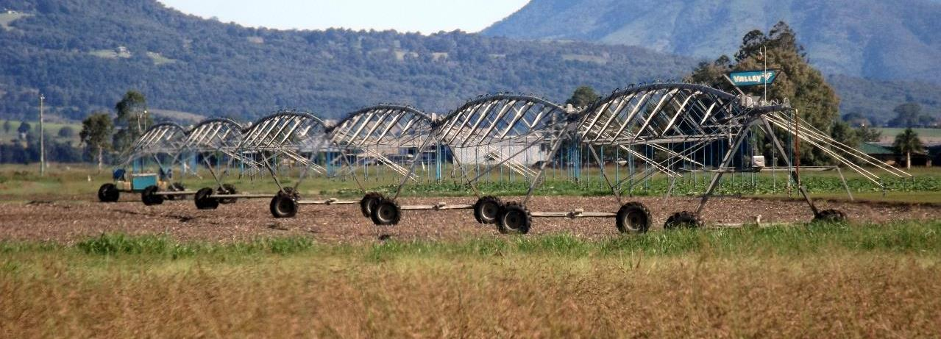
Irrigation

Slide 5
Irrigation
Year | Global irrigated area (million hectares)
1961 | 139
2009 | 301
2050 | 337
(FAO, 2011a), (Alesandratos and Bruinsma, 2012).

Slide 6
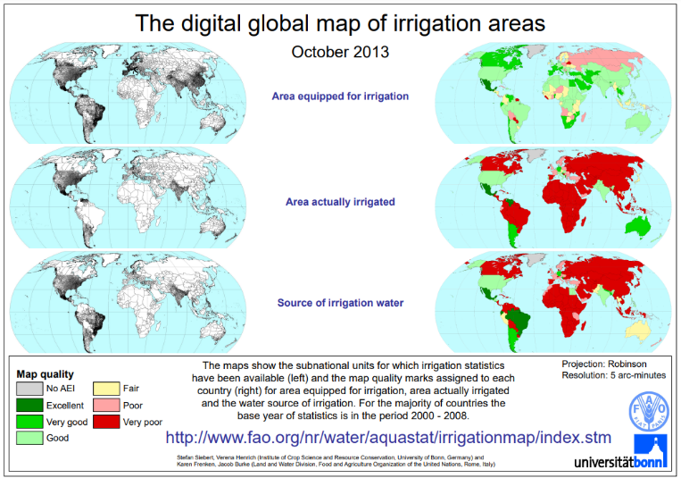
Global Map of Irrigated Areas (GMIA)
Latest version (v5) 2013
Areas equipped for irrigation around the year 2005
Resolution 5 arc mins (~10km)
Stefan Siebert, Verena Henrich, Karen Frenken and Jacob Burke (2013). Global Map of Irrigation Areas version 5. Rheinische Friedrich-Wilhelms-University, Bonn, Germany / Food and Agriculture Organization of the United Nations, Rome, Italy

Slide 7
Irrigation data challenges
EO Studies:
Global Irrigated Area Map (GIAM) (Thenkabail et al, 2009)
Identified 43% more irrigated areas than reported in official FAO statistics
A study published in 2018 using SPOT data (1999-2012) found big differences EO vs reported irrigation:
“The results globally show a 18 % larger irrigated area than existing approaches based on statistical data” (Meier, Zabel & Mauser, 2018)
GMIA
Based on regional data
Data is now old
Based on equipment – rather than actual
Funding reduced - plans for a 2015 version

Slide 8
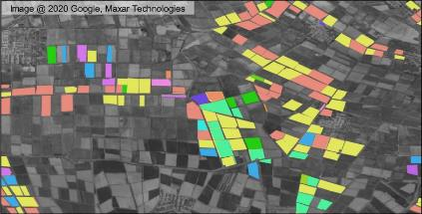
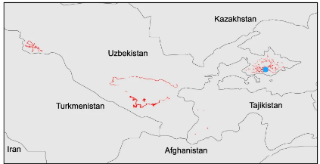
Irrigation: Search for (ground) data
Census-type data available from government sources as used in GMIA
Projects which use EO methods to spatially allocate irrigation stats (from sources above) to agricultural areas
A handful of published datasets providing the centerpoint of pivot fields
A handful of published datasets with land cover / crop classification which also recorded some irrigation information
A crop type dataset for consistent land cover classification in Central Asia (Remelgado et al. 2020)

Slide 9
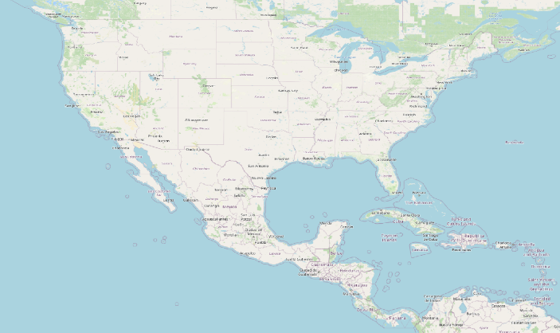
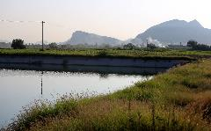
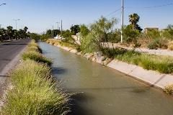
Irrigation: EO Approach
Input data:
MODIS/Terra Enhanced Vegetation Index (EVI) 16-Day L3 Global 250m.
ERA5 total precipitation climate dataset
Use precipitation data to drive CLIMEX soil moisture model
Time series comparison of ‘peak vegetation’ events and ‘peak moisture’ events
Identify irrigation events over selected time period to create an irrigation mask
Durango and Coahuila, Mexico
Irrigation Map

Slide 10

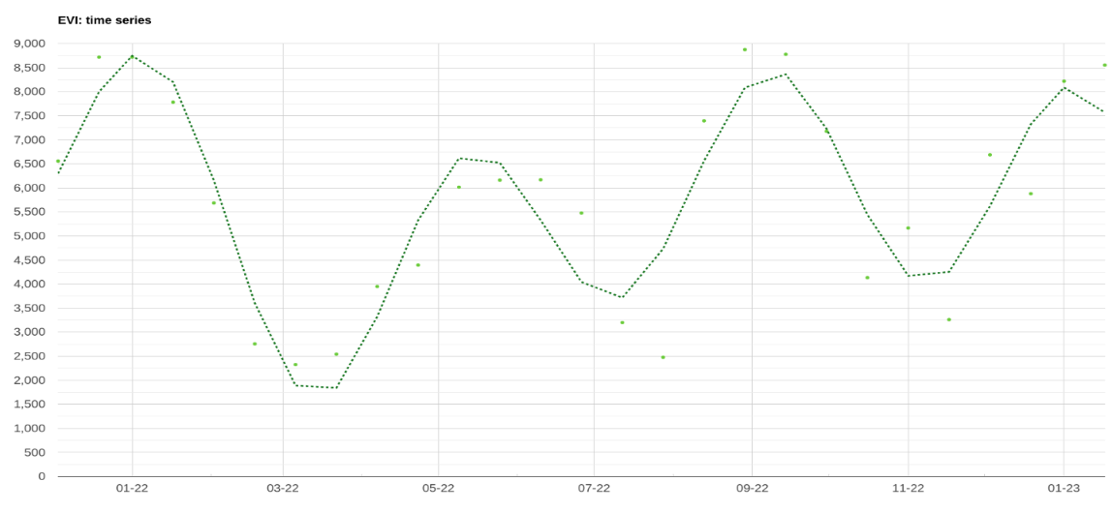

EVI time series

Slide 11
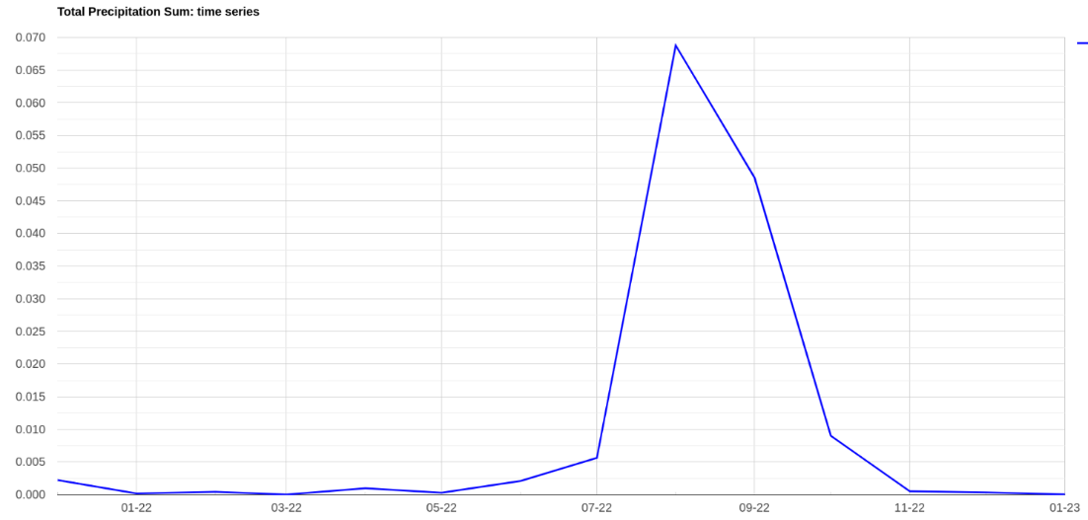


Precipitation/soil moisture time series

Slide 12
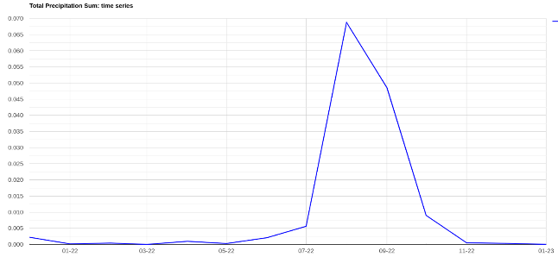
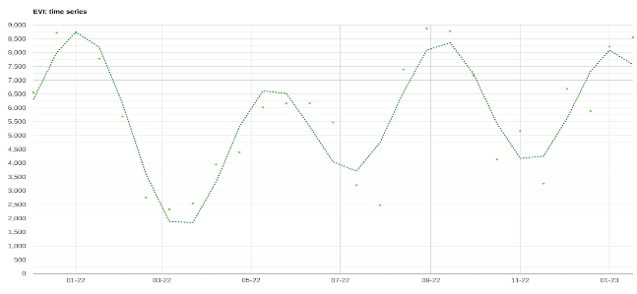
Irrigation classification

Slide 13
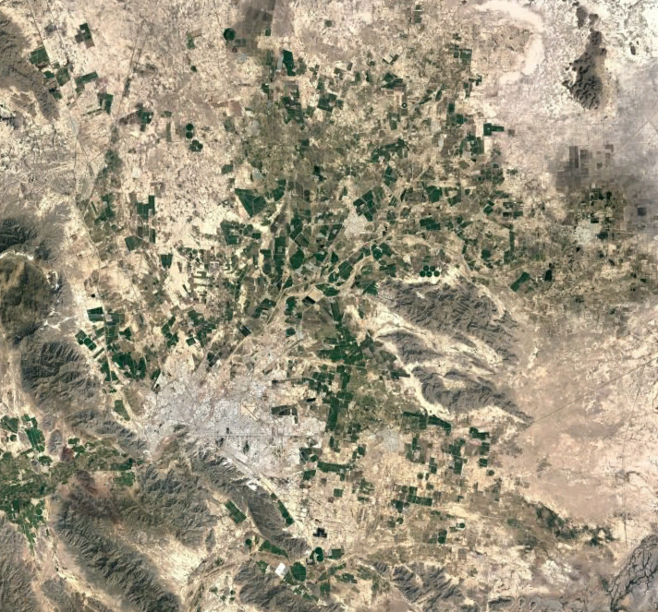
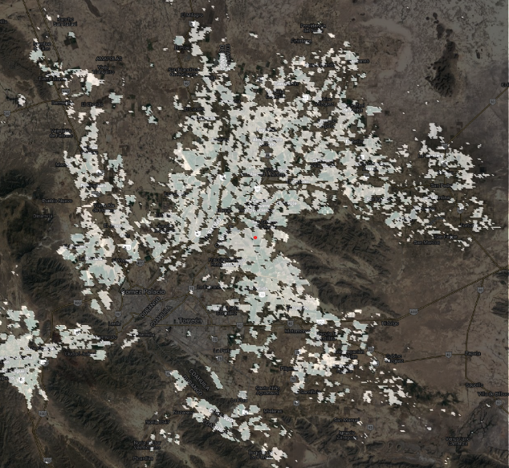

Slide 14
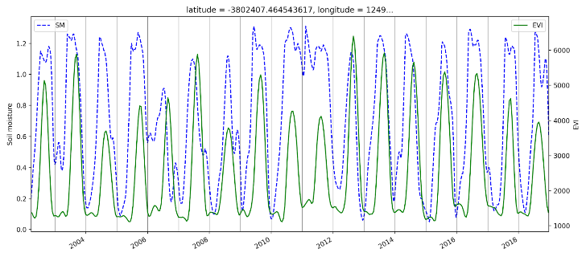
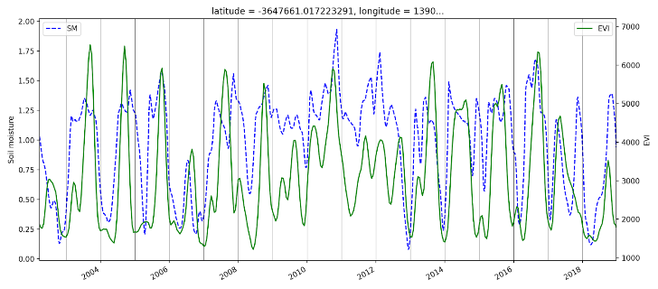
Multi-year comparison
ERA5 data was used to populate the CLIMEX soil moisture model (blue) and compared with the EVI vegetation model (green)
EVI identified rainfed cropland
→
EVI identified irrigated cropland
→

Slide 15
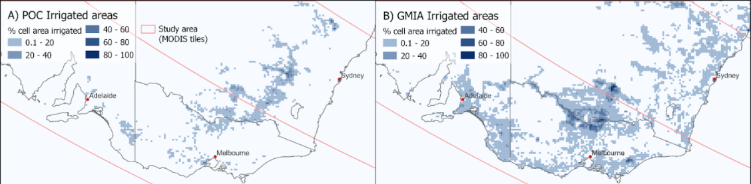
Comparison with GMIA in SE Australia
EO derived irrigated area. Using 20-year timeseries analysis method
GMIA irrigated area map. Irrigation volume data taken from a particularly wet season (2005/06)

Slide 16
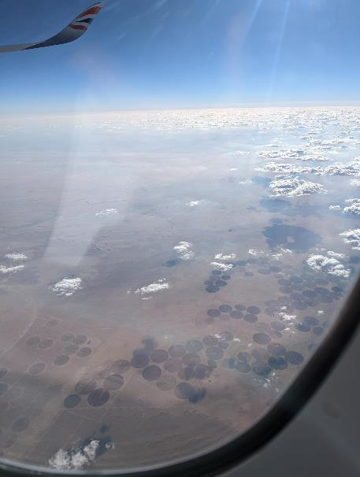
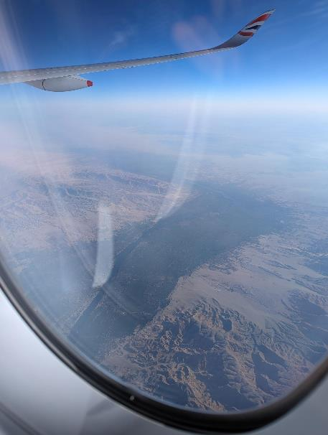

Slide 17
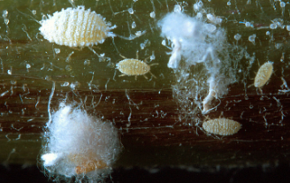
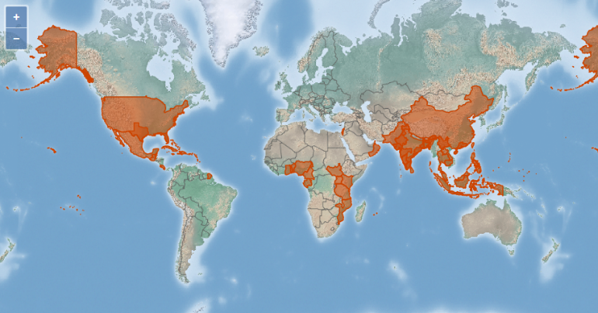
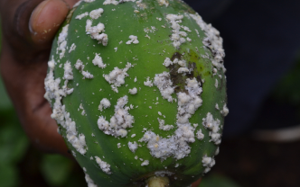
Irrigation and pest distribution
Example: Papaya mealybug (Paracoccus marginatus)

Slide 18
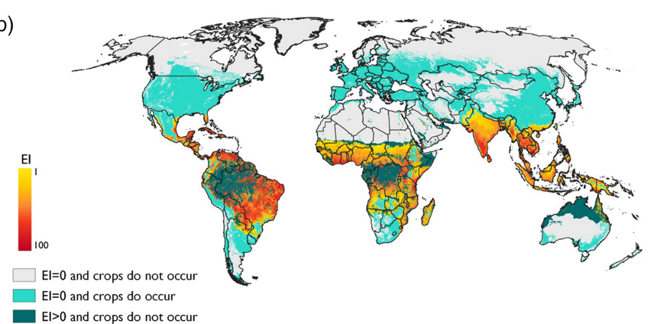
The potential global distribution of the papaya mealybug, Paracoccus marginatus, a polyphagous pest (Finch et al. 2020)

Slide 19
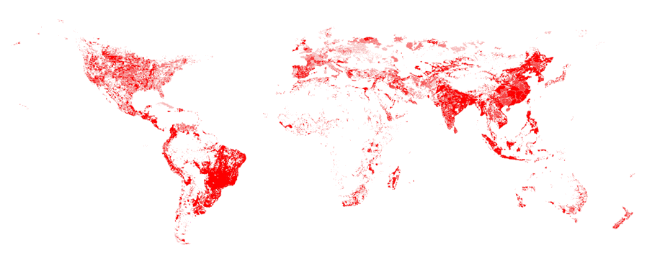
The potential global distribution of the papaya mealybug, Paracoccus marginatus, a polyphagous pest (Finch et al. 2020)
GMIA - Area Actually Irrigated

Slide 20
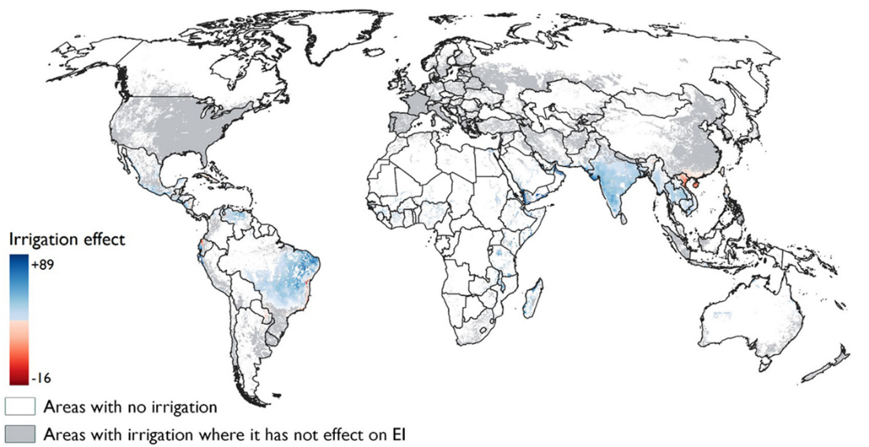
Impact of irrigation on Environmental Suitability

Slide 21
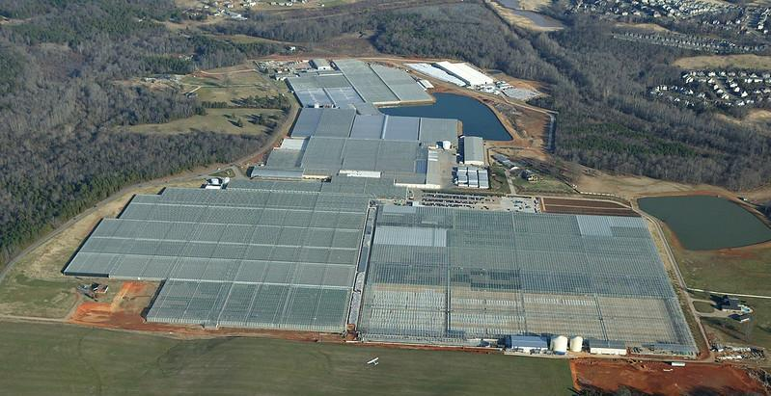
Protected agriculture

Slide 22
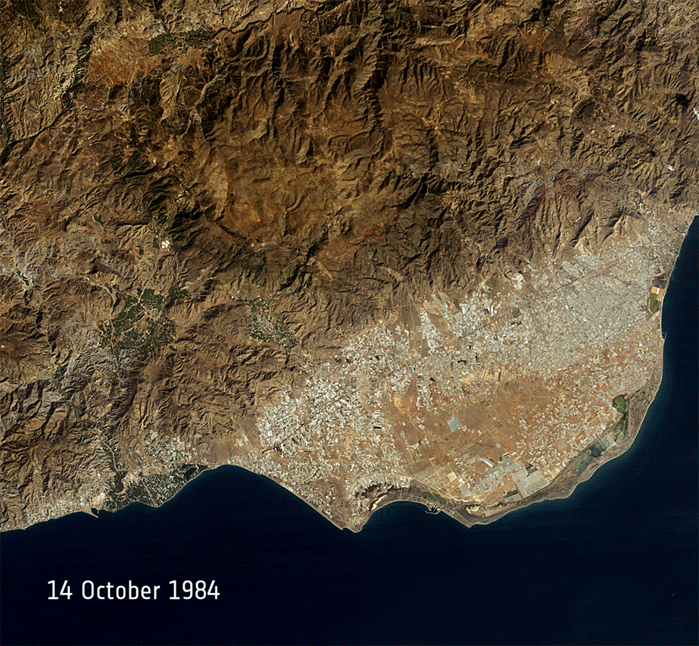
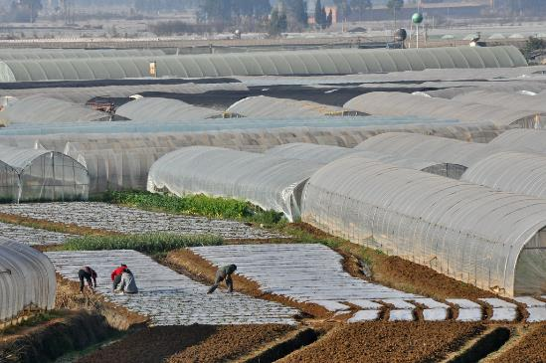
Protected agriculture
China:
3% of farmland under plastic covering (4m ha)
35% of vegetables produced under cover
‘Mar de plastico’ (sea of plastic)
Almeria, Spain (USGS/ESA)
Hot house production, Yunnan, China
(Asian Development Bank)

Slide 23
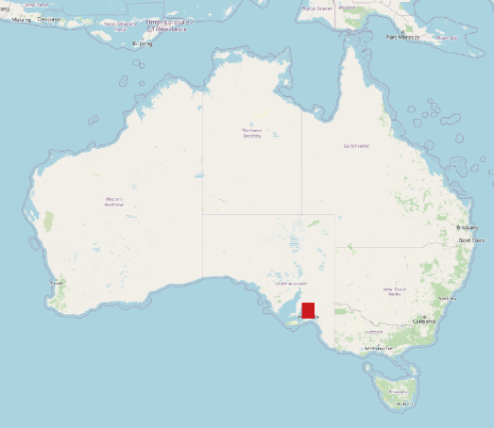
Protected Agriculture - EO approach
Input data: Sentinel 2 multispectral (10m)
(Annual multitemporal composites)
Advanced Plastic Greenhouse Index (APGI)
Normalized difference enhanced sand index
Delineated PA/non-PA training data
XGBoost binary classification
Protected Agriculture Map

Slide 24
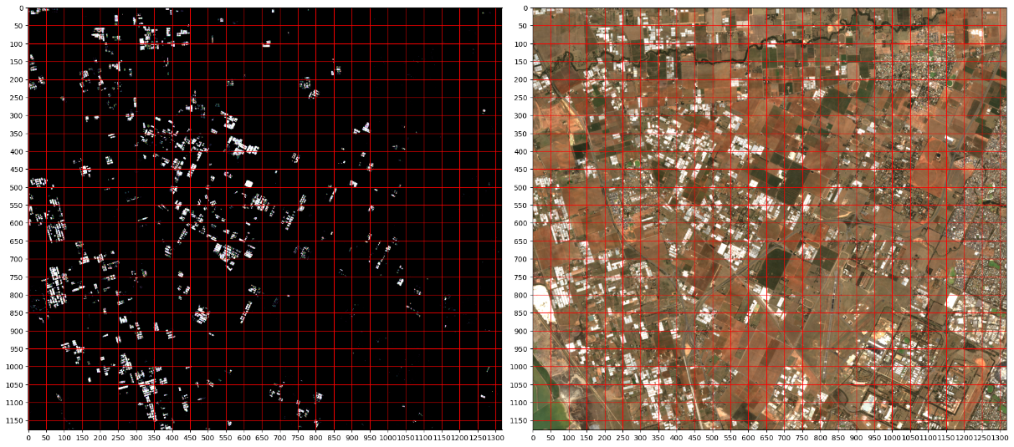
Protected Areas - EO approach

Slide 25
Protected Areas - EO approach

Slide 26
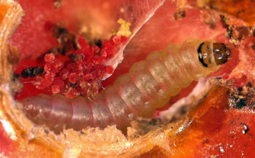
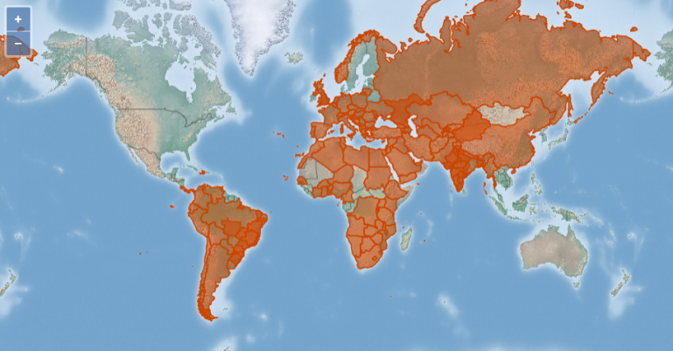
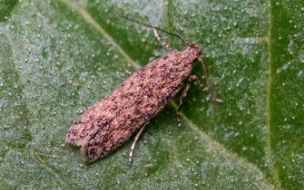
Protected agriculture and pest distribution
Example: Tomato leafminer
Tomato leafminer (Tuta absoluta / Phthorimaea absoluta)

Slide 27
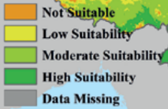
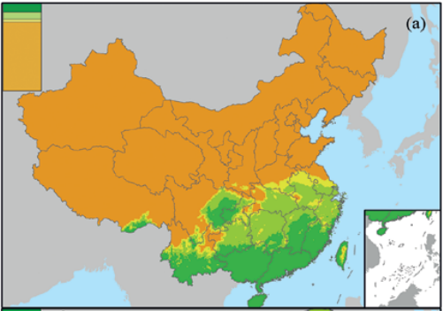
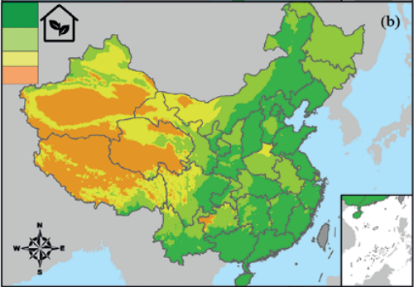
Protected agriculture matters: Year-round persistence of Tuta absoluta in China where it should not (Liu et al. 2023.)
Ecoclimatic Index (EI)
Current climate scenario (no PAs)
Ecoclimatic Index (EI)
Current climate scenario with PAs

Slide 28
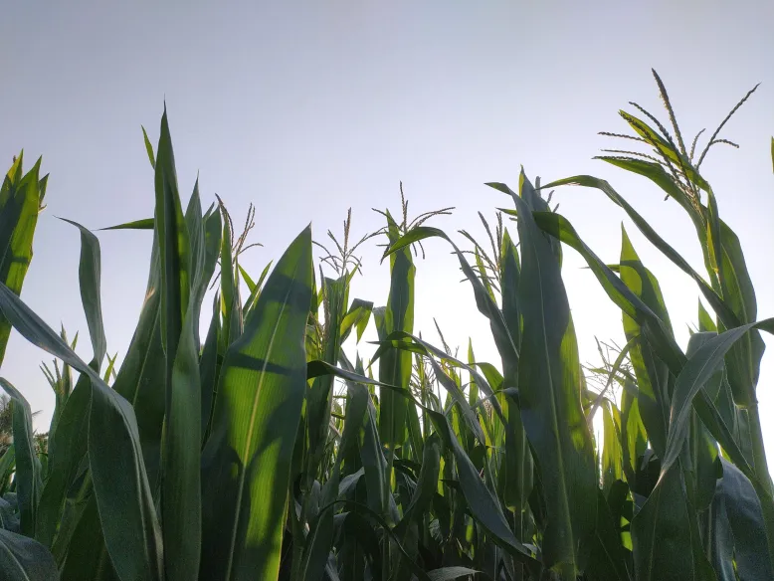
Canopy Temperature

Slide 29
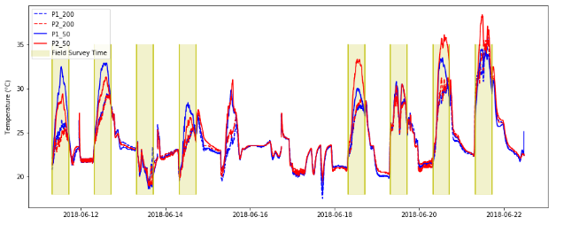
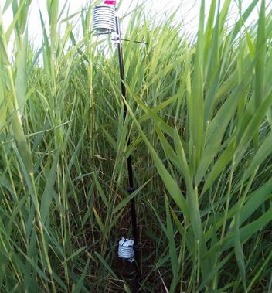
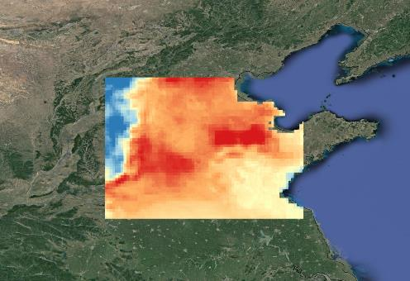

Analysing and ground truthing existing EO temperature products
2m
0.5m

Slide 30
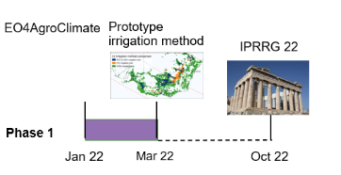
Timeline
Global irrigation data product
Protected agriculture datasets (UK & Australia)
Canopy temperature datasets (UK & Australia)
Demonstrator pest models showcasing new datasets
Papers publishing methods
Gather user feedback
IPRRG 23
Ground truthing
Refine algorithms
Validation
Pest models
Apr 23
Sept 23
Mar 25

Slide 31
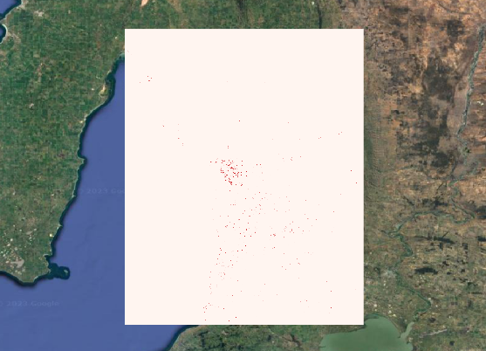
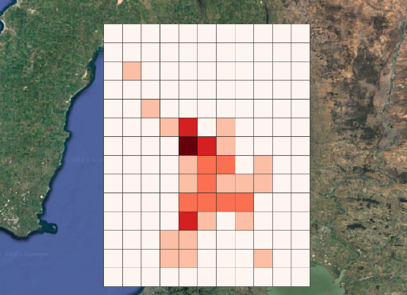
Improved datasets for pest risk modelling
Binary irrigation / PA results
High resolution (250m / 10m)
Pest modelling datasets
Transformed to regional/global scale
(e.g. a 10km grid)
Area (or % area) of irrigation / PAs

Slide 32


Uses: Identifying errors in occurrence data
Occurrence data:
Of the “Human Observation” type records (attempting to discount specimen records):
54,788 “greenhouse” records
201,535 “irrigation” records
??? unlabelled…

Slide 33
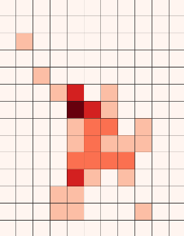
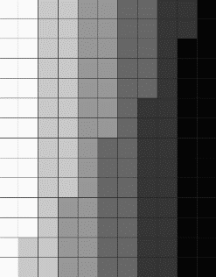
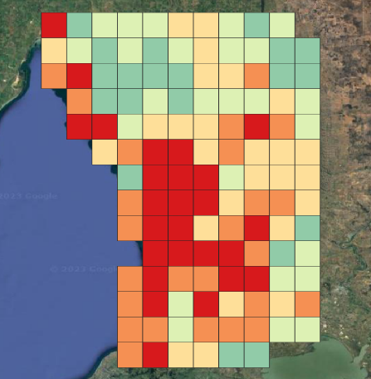
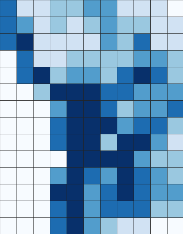
Uses: Improved risk factors
Protected agriculture
Environmental variables
Temperature
Canopy temperature
Precipitation
Koppen-Geiger zones
Climate change scenarios
Pest Risk Models
Irrigated areas

Slide 34
Feedback & Questions
Current uses / challenges around irrigation and protected agriculture in pest risk modelling?
Are there particular pests where you have experienced problems with these agricultural systems?
Requirements for the new irrigation, protected agriculture or canopy temperature data products - what should the end products look like?

Slide 35
References
This presentation is available at: https://ckan.cabi.org/data/dataset/using-earth-observation-data-to-improve-climate-modifying-habitat-datasets-for-pest-risk-modelling
Tim Beale (2023). Dataset: Using earth observation data to improve climate-modifying habitat datasets for pest risk modelling. CABI Datasets. https://doi.org/10.34857/0023606
Araújo Soares, M., & Ribeiro Campos, M. (2022). Phthorimaea absoluta (tomato leafminer) [dataset]. In CABI Compendium. CABI Publishing. https://doi.org/10.1079/cabicompendium.49260
Finch, E. A., Beale, T., Chellappan, M., Goergen, G., Gadratagi, B. G., Khan, M. A. M., Rehman, A., Rwomushana, I., Sarma, A. K., Wyckhuys, K. A., & Kriticos, D. J. (2020). The potential global distribution of the papaya mealybug, Paracoccus marginatus, a polyphagous pest. In Pest Management Science (Vol. 77, Issue 3, pp. 1361–1370). Wiley. https://doi.org/10.1002/ps.6151
Liu, X., Yang, M., Arnó, J., Kriticos, D. J., Desneux, N., Zalucki, M. P., & Lu, Z. (2023). Protected agriculture matters: Year-round persistence of Tuta absoluta in China where it should not. In Entomologia Generalis. Schweizerbart. https://doi.org/10.1127/entomologia/2023/1784
Tonnang, H. E. Z., Mohamed, S. F., Khamis, F., & Ekesi, S. (2015). Identification and Risk Assessment for Worldwide Invasion and Spread of Tuta absoluta with a Focus on Sub-Saharan Africa: Implications for Phytosanitary Measures and Management. In R. N. C. Guedes (Ed.), PLOS ONE (Vol. 10, Issue 8, p. e0135283). Public Library of Science (PLoS). https://doi.org/10.1371/journal.pone.0135283
Watson, G. (2022). Paracoccus marginatus (papaya mealybug) [dataset]. In CABI Compendium. CABI Publishing. https://doi.org/10.1079/cabicompendium.39201

Slide 37
Abstract
Non-climatic habitat factors can have a significant effect on species ranges, allowing them to persist well beyond their natural ranges. Irrigation and protected agricultural structures such as glasshouses are used specifically to allow crop species to be grown successfully in locations where the climate is otherwise inhospitable. The same conditions that allow the crops to be grown in hostile climates allows pest species to persist beyond their natural limits. Species distribution databases such as GBIF and iSCAN do not distinguish between species distribution records collected from natural habitat situations and those from artificial habitat. Bioclimatic models that ignore the role of these artificial habitat modifications routinely make egregious errors, incorrectly projecting habitat suitability into inclement climates. Methodically overestimating the pest risk area in this manner can have important effects on biosecurity risk management, misdirecting resource allocation for preparedness activities, and undermining the reputation of pest risk assessment.
Advances in Earth Observation (EO) technology have opened up new possibilities for addressing agricultural challenges in the face of climate change. The EO4AgroClimate project is using EO-derived data to enhance three critical modelling datasets: irrigation, protected agriculture, and canopy temperature. These datasets will help to contextualise species distribution data from repositories, as well as improve the performance of environmental niche models (ENM) leading to more accurate, high-resolution, and timely information for pest risk assessment.

